Slide 1



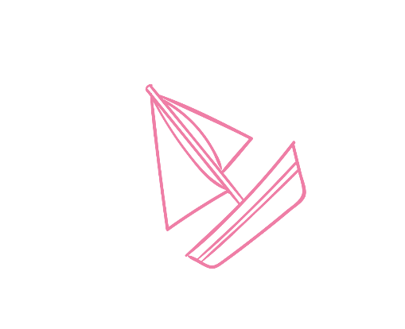

by mani kiran reddy
vpc
virtiual private cloud

Slide 2
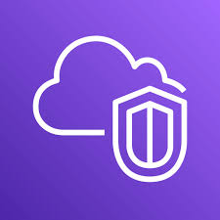
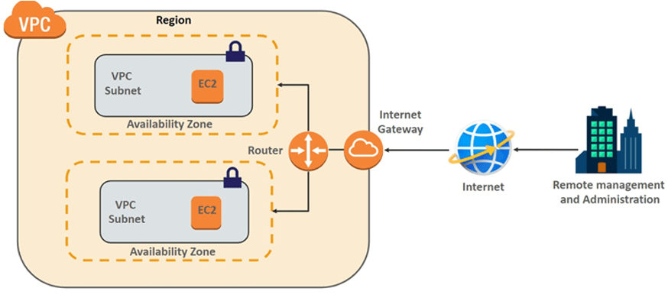
Introduction to VPC
vpc in AWS :virtiual private cloud
vpc in azure :virtiual network
where ever we are creating instances by default we are assigining vpc configuration
vpc play very important role in order to comunicate from one instance to another
Offers control over networking environment, including IP addressing, subnets, route tables, and gateways.
vpc to assign networking
vpc to assign IP addresess
only we can create 5 vpc’s

Slide 3
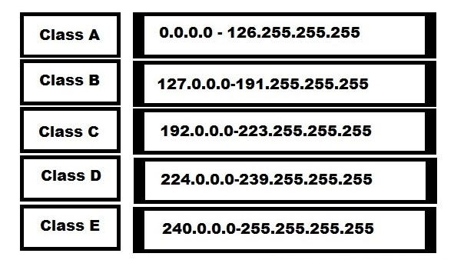
CIDR(CLASSLESS INTER DOMAIN RANGE)
for every VPC we need to configure one CIDR range.
The privante IP of Ec2 which got assigned, will be under CIDR Range.
172.168.0.0/32 → Max in aws and azure
172. 168.0.0/16 → Minimum in aws
172. 168.0.0/08. → Minimum in Azure.
Max-bits - no of subnet masking assigned
= 32-16
= 16.
2^16 = 65,536 IP adresses are been assigned to 172.168.00/16

Slide 4
Components of a VPC
Component Description
Subnets Segments within the VPC (public/private)
Route Tables Define traffic rules
Internet Gateway Enables internet access for public subnets
NAT Gateway Allows private subnets to access the internet
securely
Security Groups Stateful virtual firewalls for EC2
NACLs Stateless firewalls for subnets

Slide 5
Subnets
subnets are the range of IP4 address in the vpc
subnets is alogical subdivision of larger network.
1)public subnet:having internet access.
2)private subnet:having no internet access.
Route tables
Route table is used to route the trafic to trgeted subnets.
Route tables contains routes,which specify paths to different network destinations.

Slide 6
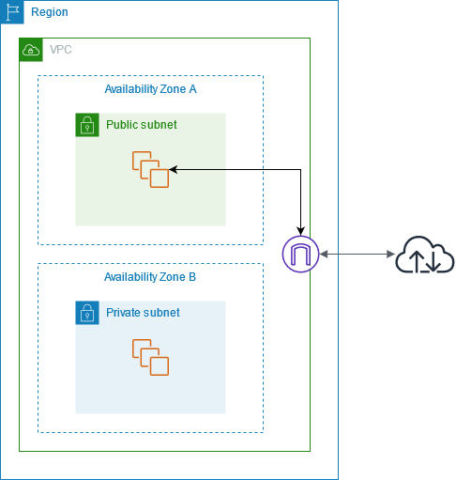
INTERNET GATEWAY
This service is responsible to provide inbound and outbound access.
A route table associated with the public subnet includes a route pointing to the Internet Gateway .
EC2 instances in that subnet must have a public IP to access the internet.
Only attach IGW to subnets that require internet access.

Slide 7




Nacl and Sg
SG
Security Groups.
Both are firewalls used to avoid unauthorized traffic.
By default everything is deney the request.
will restrict access at instance level.
security groups are in our user hands.
NACL
Network access control list.
Both are firewalls used to avoid unauthorized traffic.
In this NACL we can allow or deney the request.
will restrict access at subnet level .
NACL will work based on rule number.

Slide 8
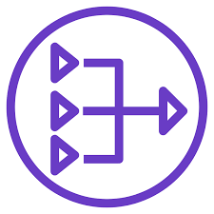
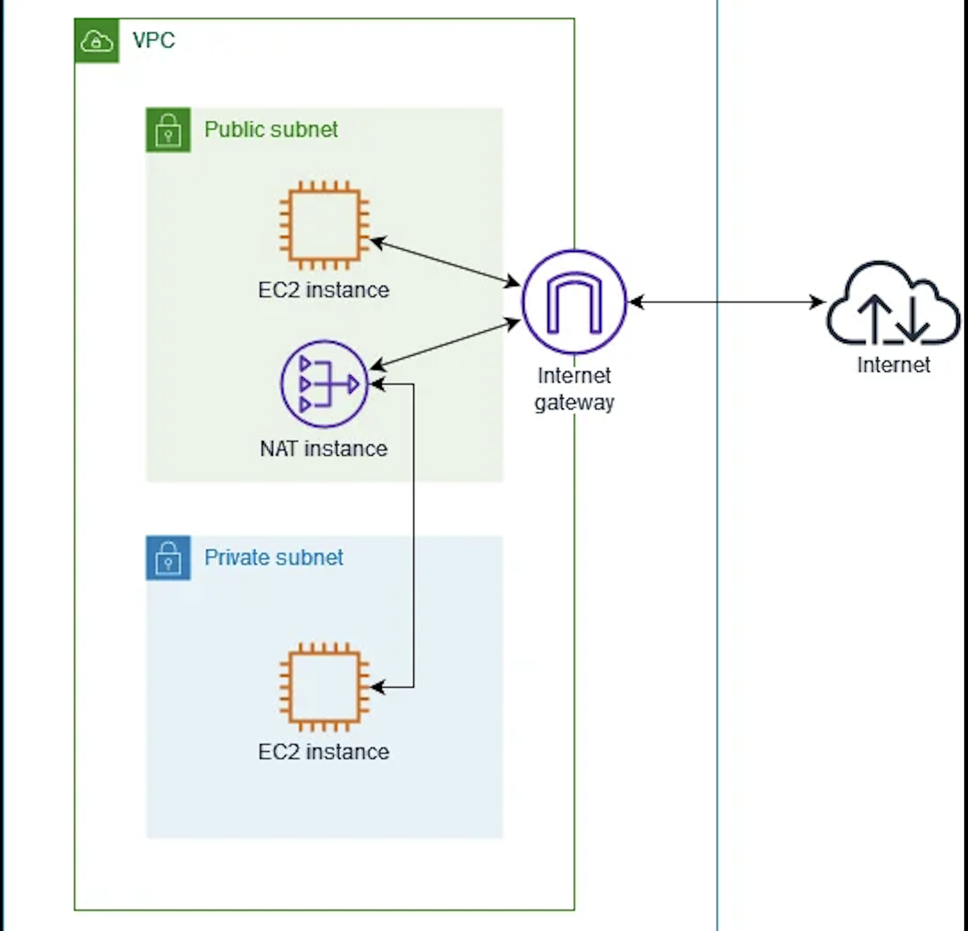
NAT GATEWAY
Nat gateway will help us to provide internet access to the instances which are in the private subnets
we should always deploy our Nat in the public subnets only.
we will configure our nat through the route table
when we creating nat we should deploy elastic IP address.

Slide 9
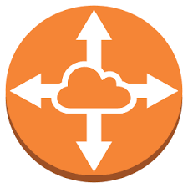
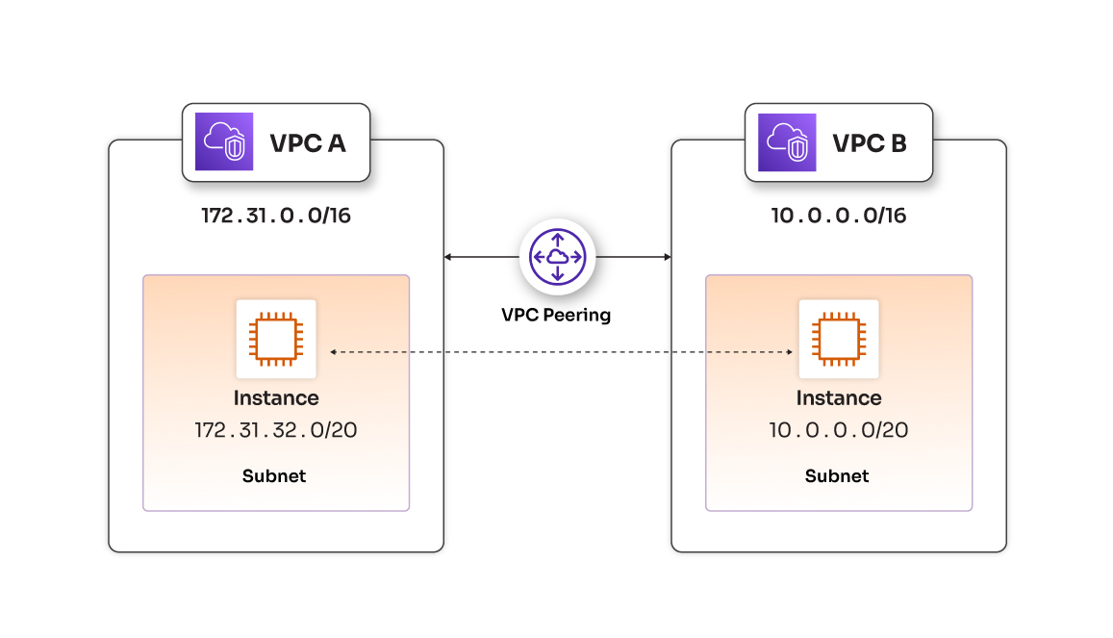
VPC PEERING
VpC peering allows private communication between two VPCs without using an internet gateway, UPN.,
VPC peering will help us to connect/communicate between two multiple VPC’s in same region or different region.
The only condition is “no two CIDR range should be overlapped” the CIDR range should be different.
Billing will be charged based on trafering the data.

Slide 10
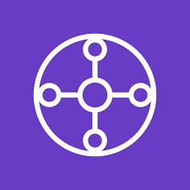
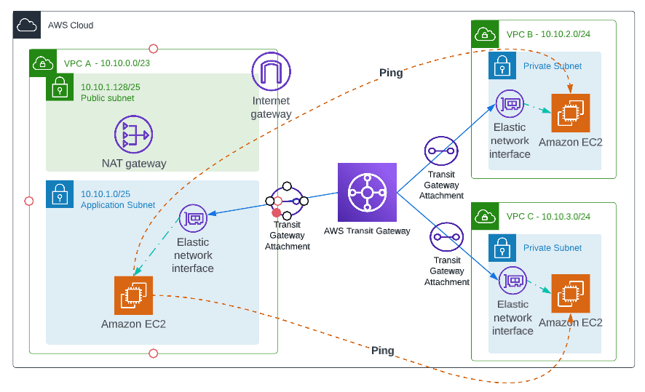
Transit Gateway
It we are have a big project, and there are 20 vpc’s to get connected, we cant use vpc peering.
Then we will be using Transit gateway to connect to more number of vp’s.
The configuration is much easier than vpc peering.
Transit gateway is chargable.
Transit gateway has two mechanisms.
1) vpc Attachment charge.
2) Data processing.

Slide 11

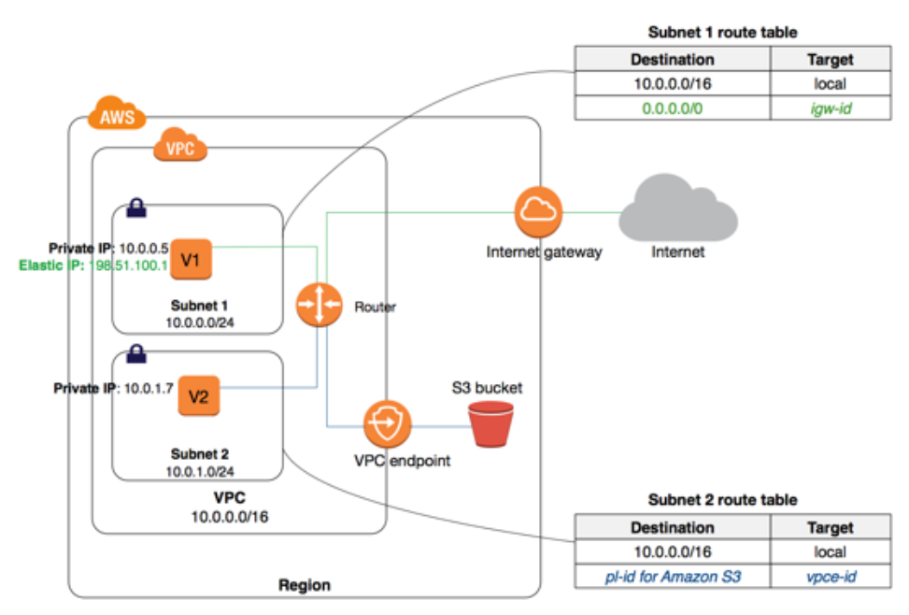
VPC
VPC ENDPOINT
If i don't want to use the NAT gateway, but i Still want to communicate with my Aws resources, then we will be using the VPC Endpoint.
End Point will help us to access our AWs resources
Privetly.
With the help of Vpc endpoint, all our request will not travel over the internet. It will communicate using Private links. and will be within VPC.
VPC Endpoint service will help us to communicate with AWS services without internet.
To setup VPc endpoint we need to have one private subnet and one public subnet.

Slide 12
Conclusion
Amazon VPC is the foundation for secure and scalable cloud networking, offering full control over your virtual network environment.
NAT Gateways enable secure outbound internet access for private subnets without exposing internal resources.
VPC Peering provides direct, private connectivity between two VPCs, best suited for smaller or simpler architectures.
Transit Gateway is the scalable, centralized solution for connecting multiple VPCs and networks in large, complex environments.
Choosing the right solution depends on your network size, scalability needs, and management preferences.
ENTER TITLE
ENTER TITLE
ENTER TITLE

Slide 13
Thanks for you attention

